Slide 1
Smart Home Temperature Alert System
EMİR AKSAKAL 19COMP1030
&
RANA SELİM 19COMP1009

Slide 2

Problem defınıtıon
Temperature sensors are an important IoT device as they allow for real-time monitoring of temperature in various settings. In a home, for example, a temperature sensor placed in a child’s room can help parents ensure that the room remains at a comfortable and safe temperature. This can be especially important for children, babies or animals who are more susceptible to temperature-related health issues. Additionally, temperature sensors can be used to monitor the temperature of refrigerators, which can help detect if the refrigerator is malfunctioning and needs to be repaired.
Notes:
There are hardware exist that measures temperature but they are expensive. we have developed an app that can do this cheaper

Slide 3
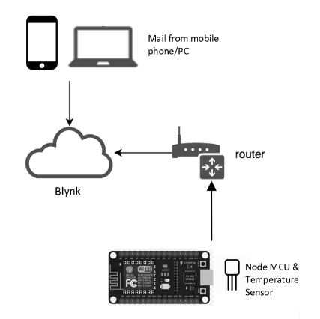
PROBLEM SOLUTION
We designed a hardware that measures temperature using temperature sensor, board and Node MCU, and using an application(blynk), we will warn the user by sending notifications and e-mails when the temperature exceeds the threshold value that we evaluate.

Slide 4
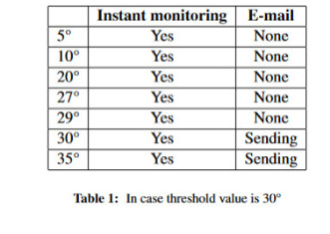
Test Results

Slide 5
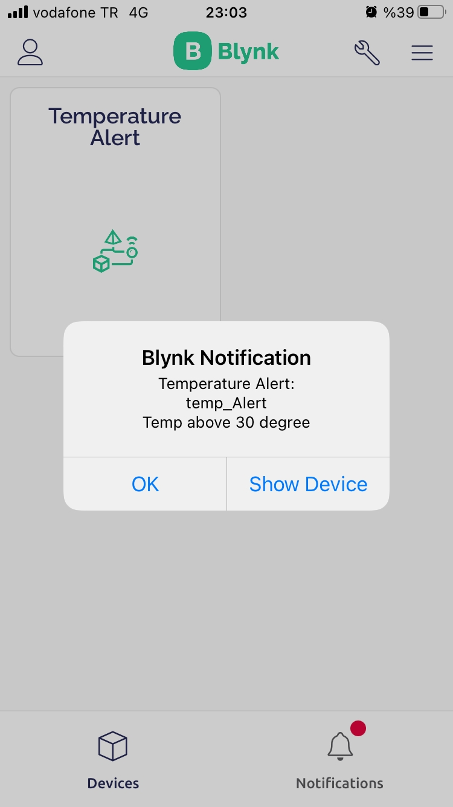
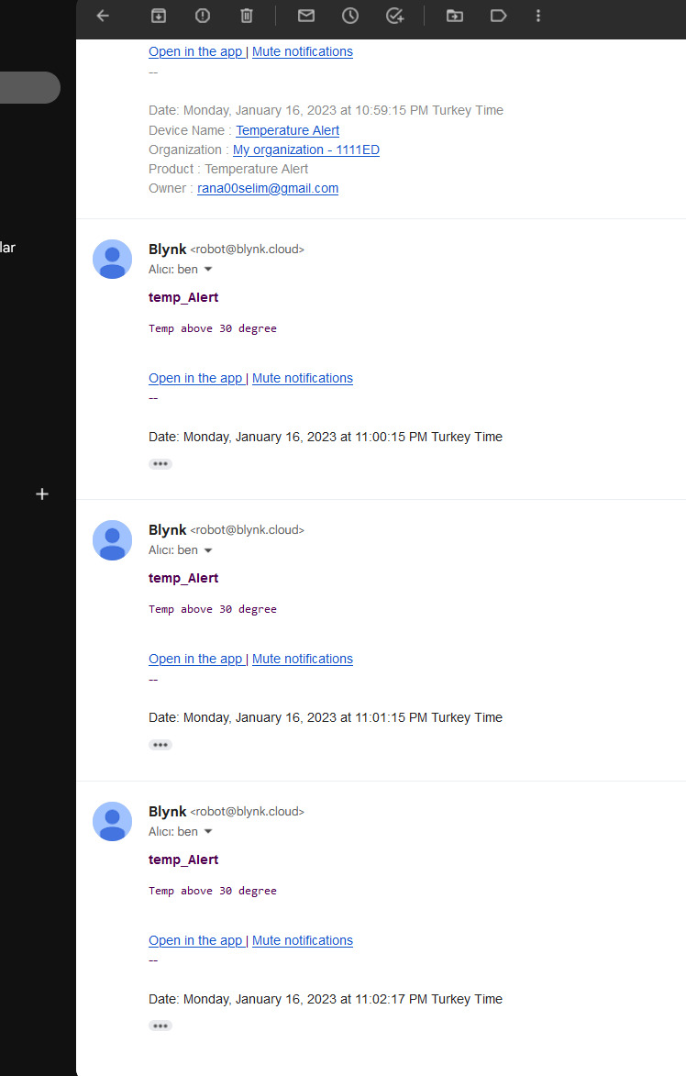
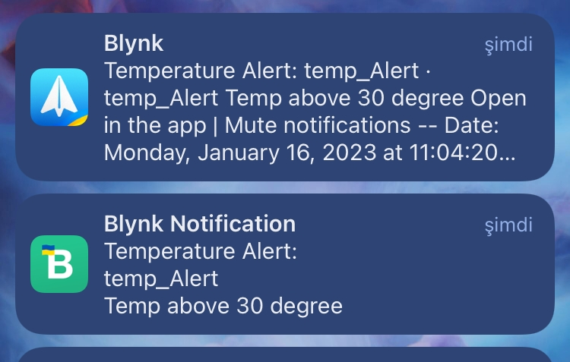
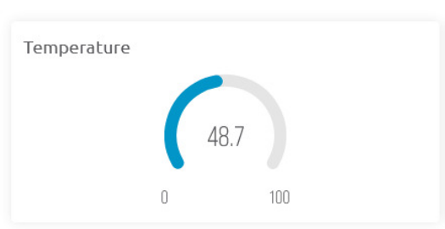
Test Results

Slide 6
Future Works
In future, we could consider testing the system in a real-world environment to ensure its performance in different conditions. Additionally, we could add additional sensors to monitor humidity, motion, or other factors that could affect temperature. The system could also be enhanced with more advanced machine learning algorithms to analyze the data and provide more accurate predictions or recommendations.

Slide 7




THANK YOU

